Slide 1
Project 3 WIP May 4 Tableau
File created on: 5/6/2019 9:57:42 PM

Slide 2
Pre Machine Learning Model Tableau Data Review
Original data set has over 1,800 columns of national housing data
Scoped the data to around 20 housing + neighborhood features along with market value records
Used Tableau to review different data points correlation to Market Value – to hone in on which values to focus on in building the ML model

Slide 3
Housing Features w/Weak Correlation to Market Value

Slide 4
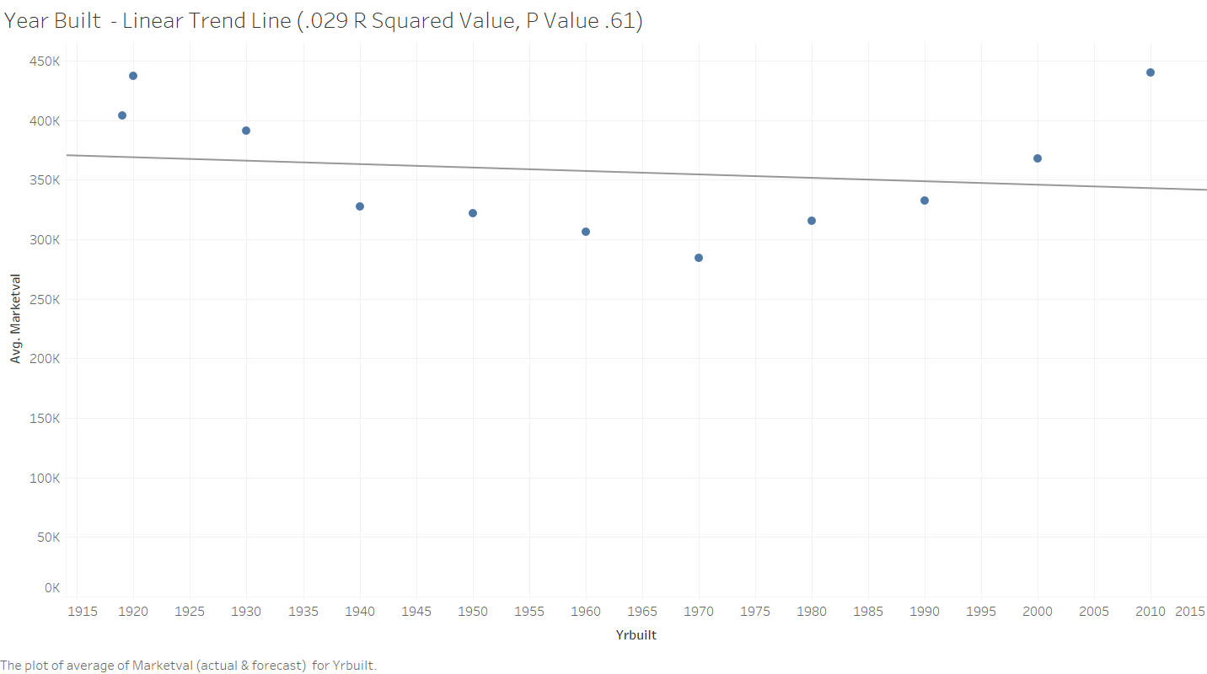

Slide 5
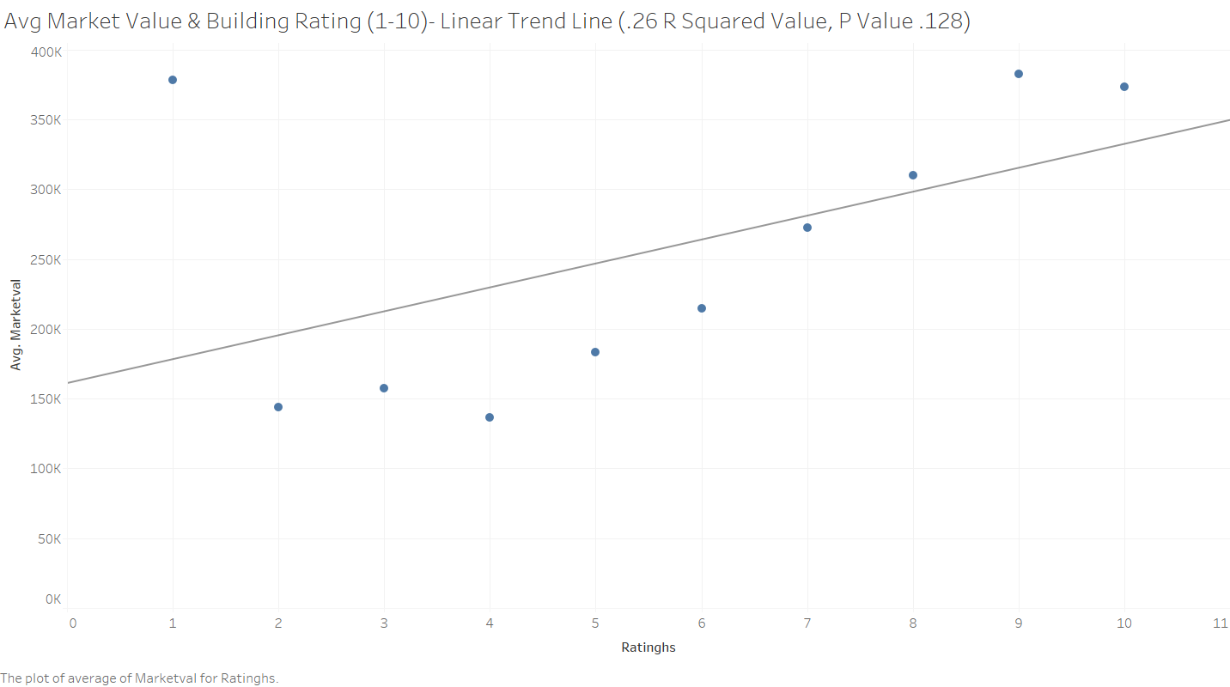

Slide 6
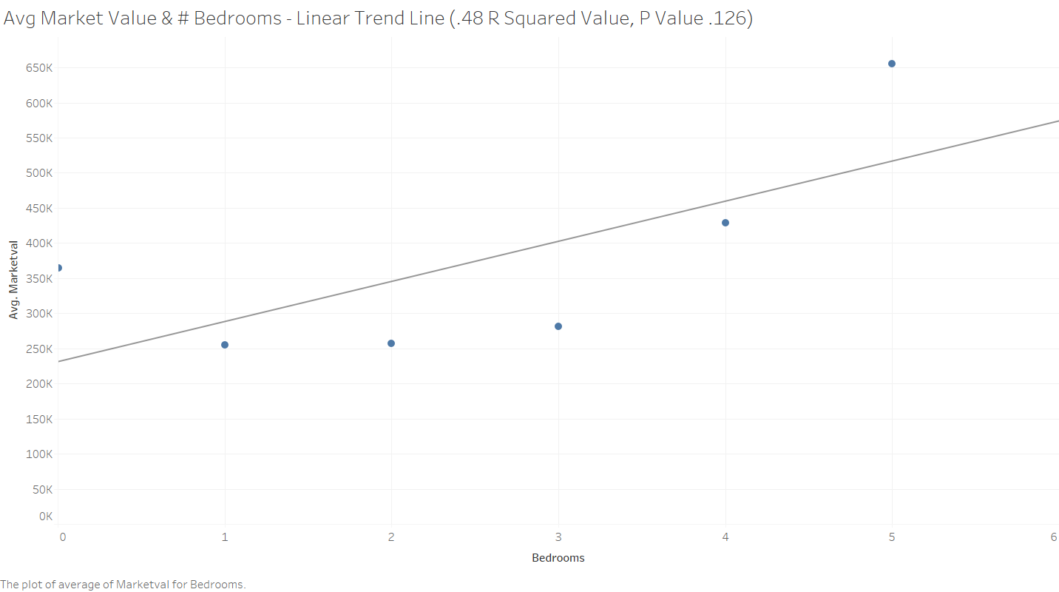

Slide 7
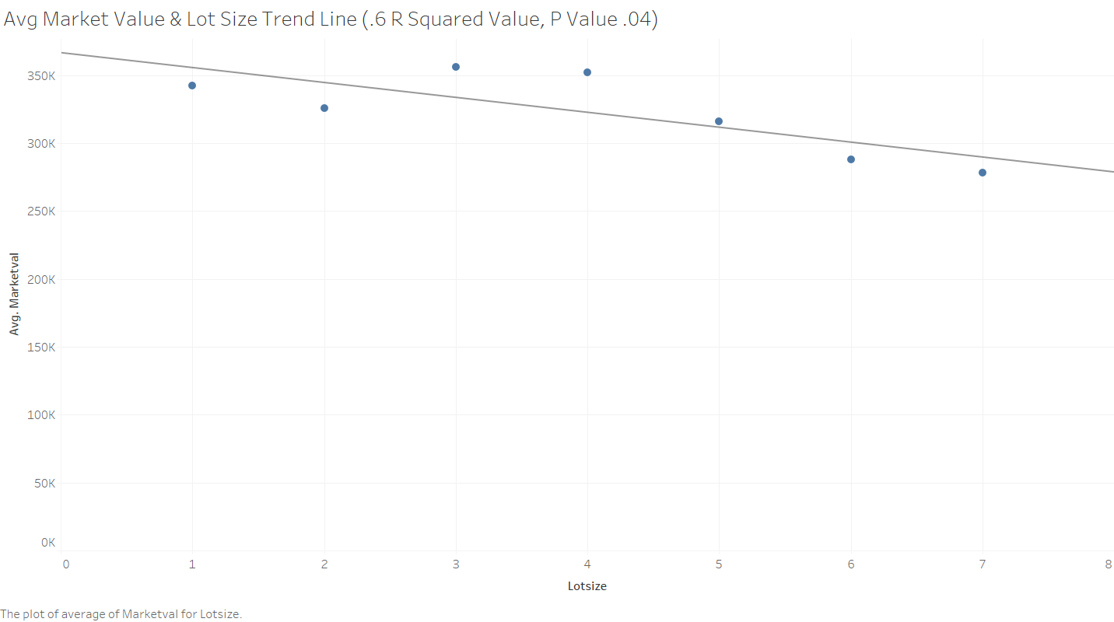

Slide 8
Housing Features w/Strong Correlation to Market Value

Slide 9
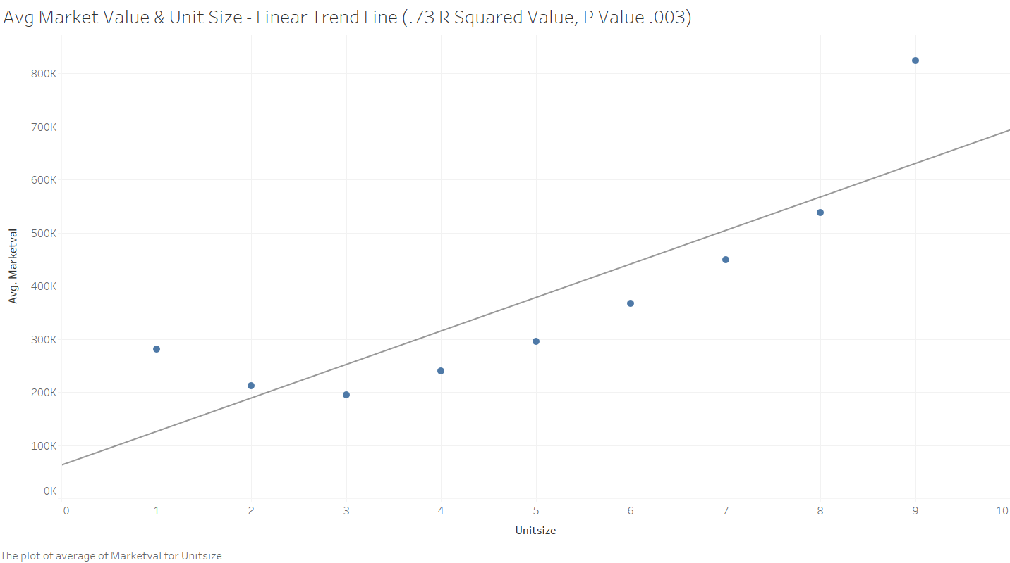

Slide 10
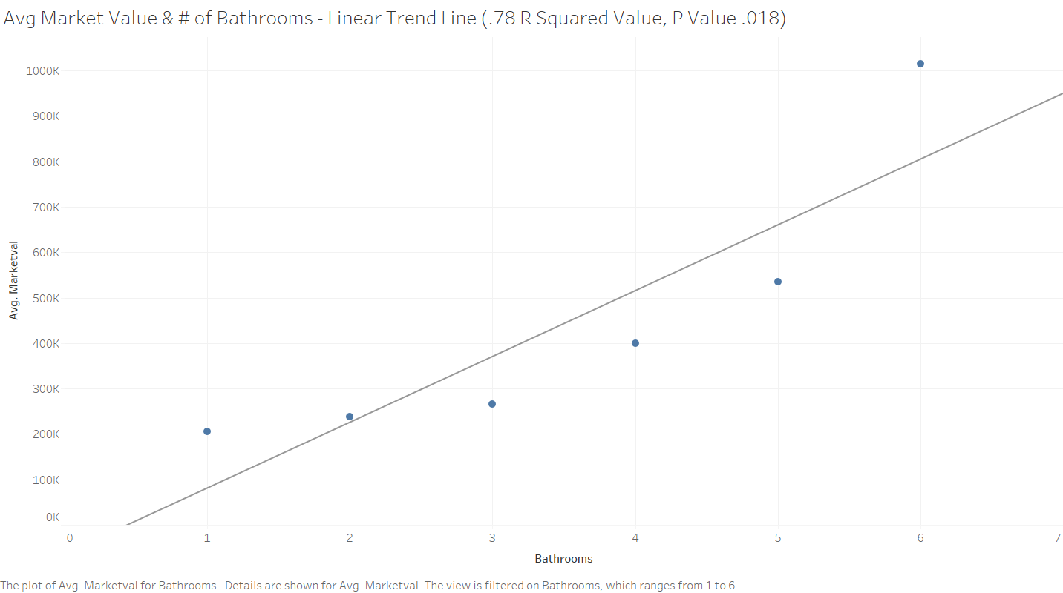

Slide 11
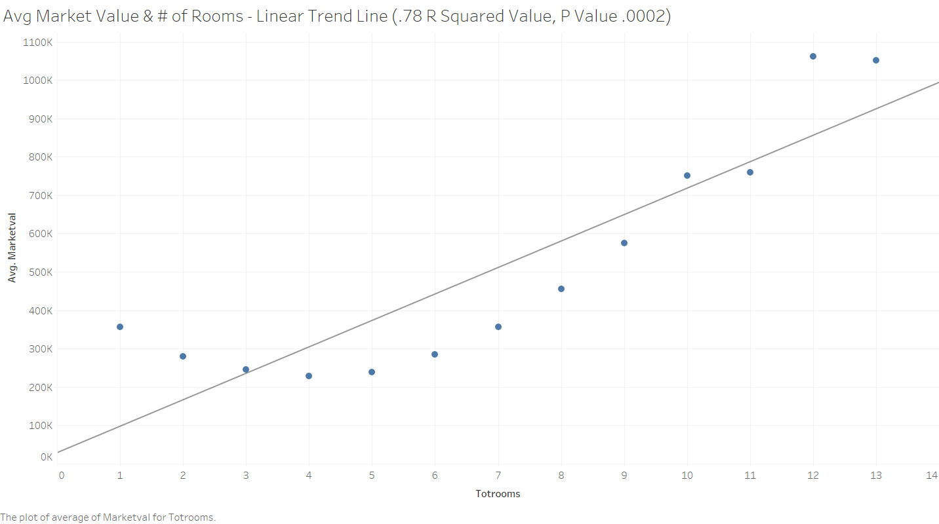

Slide 12
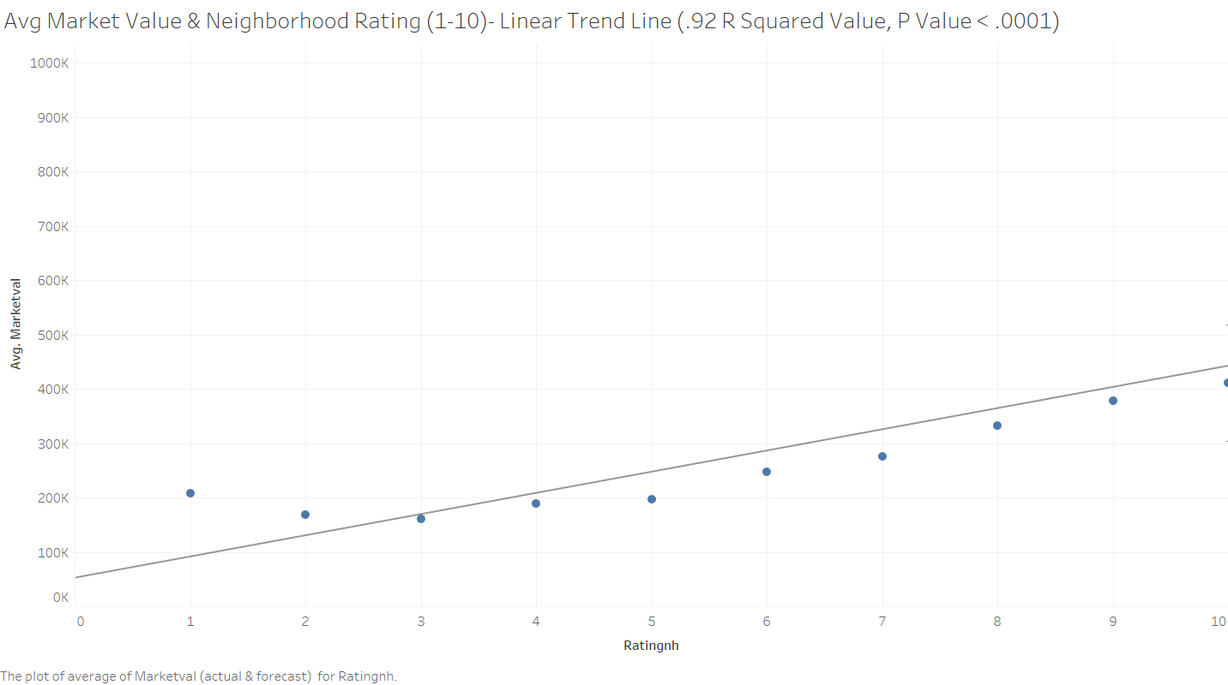

Slide 13
Interesting Trend Data We Found

Slide 14
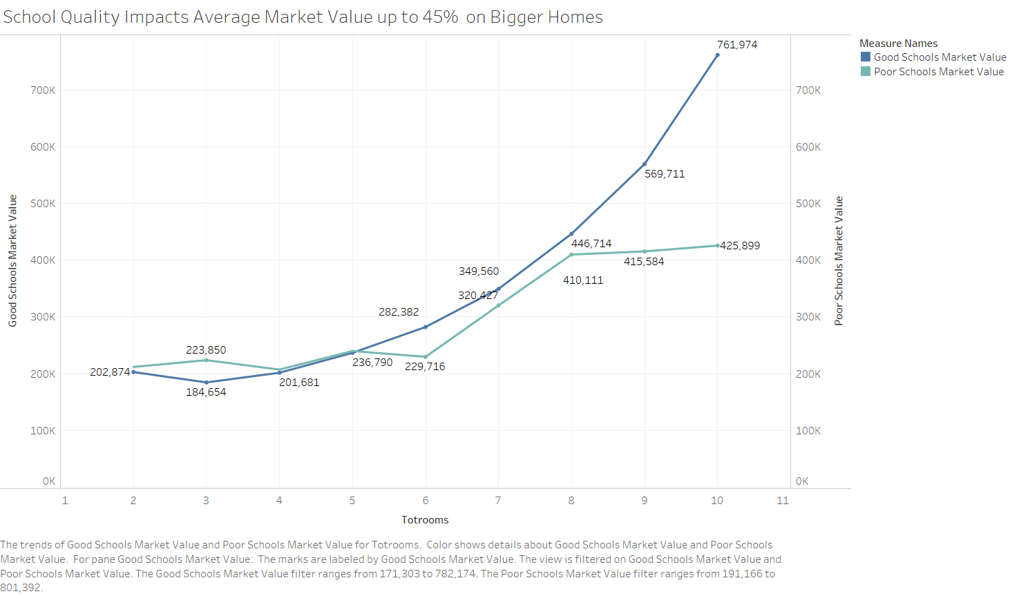

Slide 15
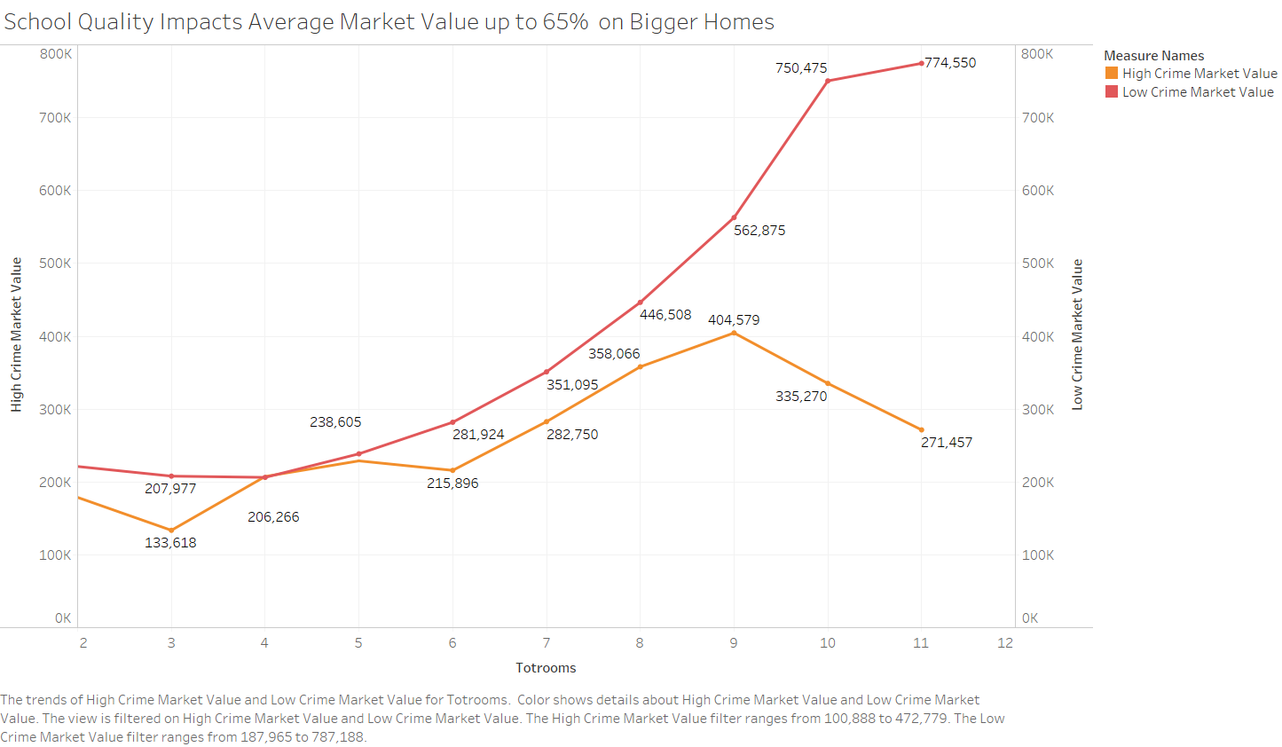

Slide 16
Appendix/Optional Slides

Slide 17
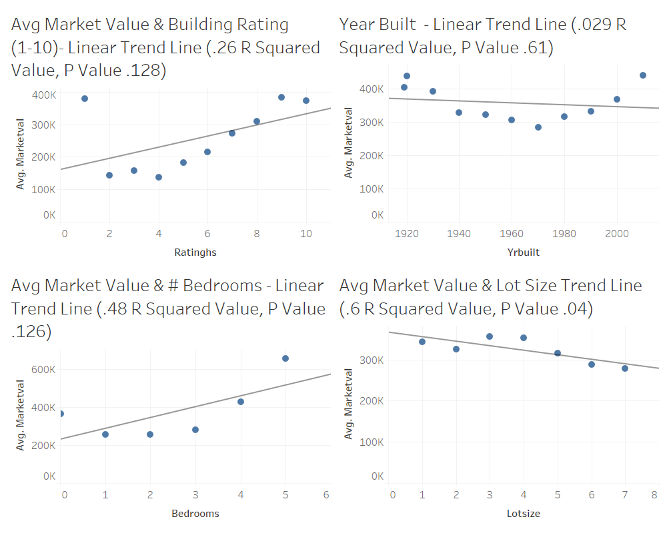

Slide 18
